Slide 1
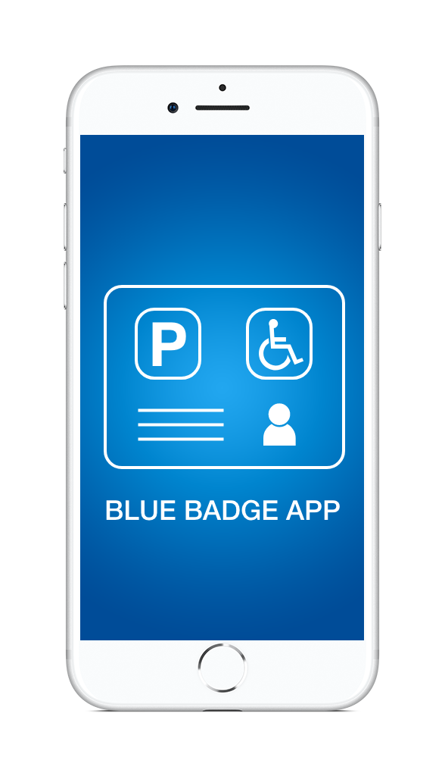
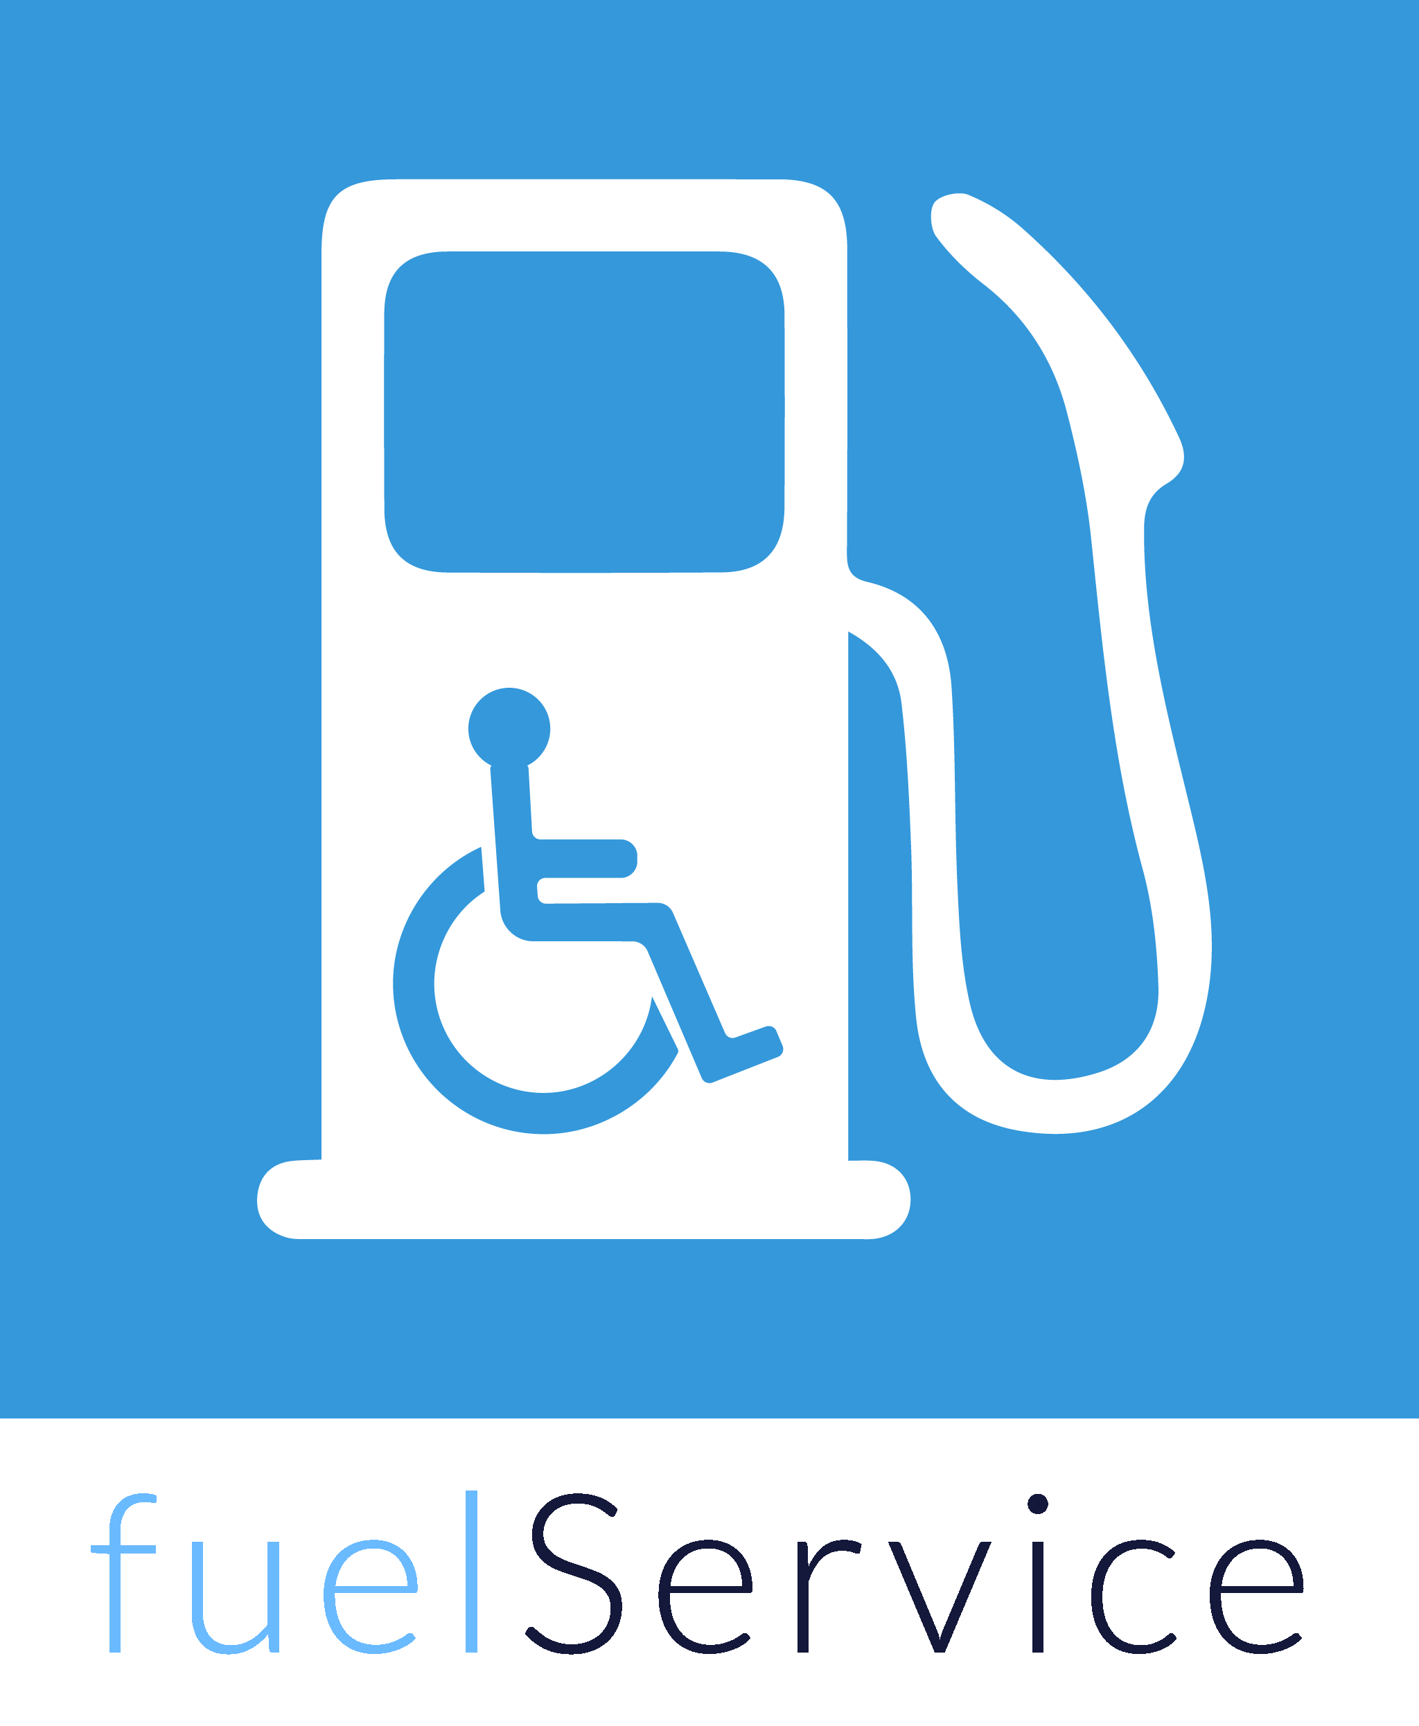



Slide 2
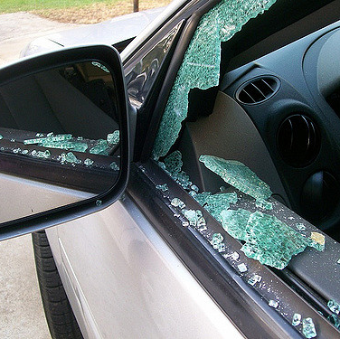
But Why? What’s wrong with the card?
60% of thefts from motor vehicles are
blue badge thefts*
Blue badge thefts have quadrupled in last 5 years**
Targets vulnerable people with disabilities
  Loss of independence
  Repair Costs/Insurance Excess Payment
  Increase in insurance premiums
Would you leave £6000** on your dashboard?
*London Borough of Tower Hamlets Figures 2017 **Local Government Association estimates a badge could be worth at least £6,000 a year in saved parking fees

Slide 3
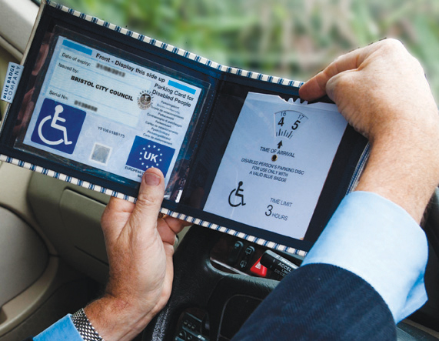
What do disabled drivers think?
Current badge is too big
  Great for display in the window
  Poor for carrying about
Often left at home or another car
  Not having the badge is a problem for independence
Forgot to put the badge in the window
  When you have mobility problems, having to go back can be a challenge

Slide 4
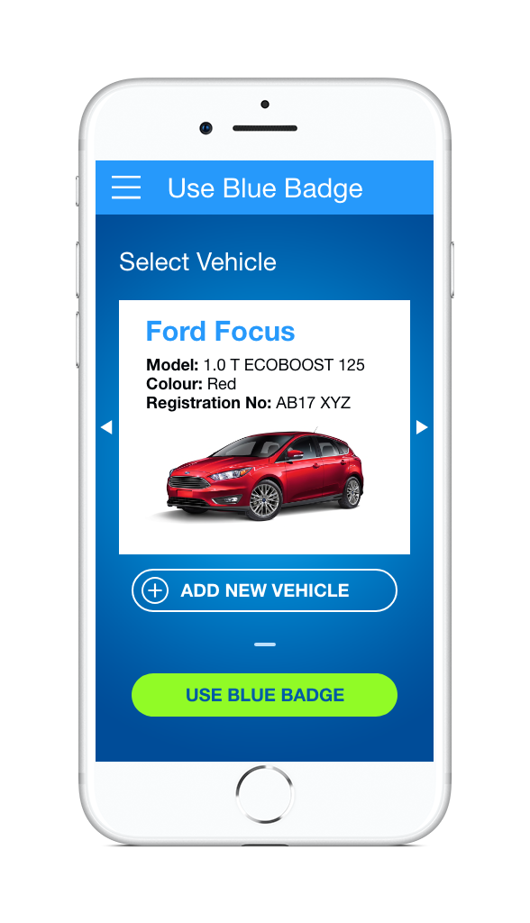
So just use your phone!
Nothing valuable left in the car
  Nothing for anyone to steal
Always have it with you
  Not left at home or other car
It’s in your pocket
  Not another big thing to carry
  Especially with the amount of other things disabled people need to carry/remember
Everything is on your phone today

Slide 5
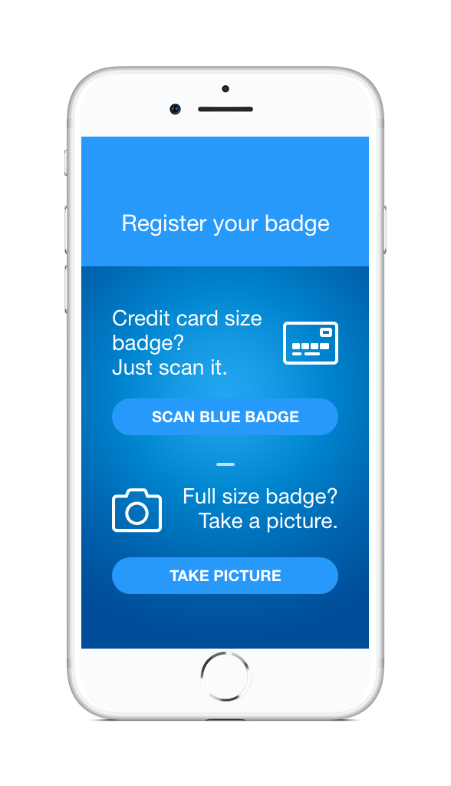
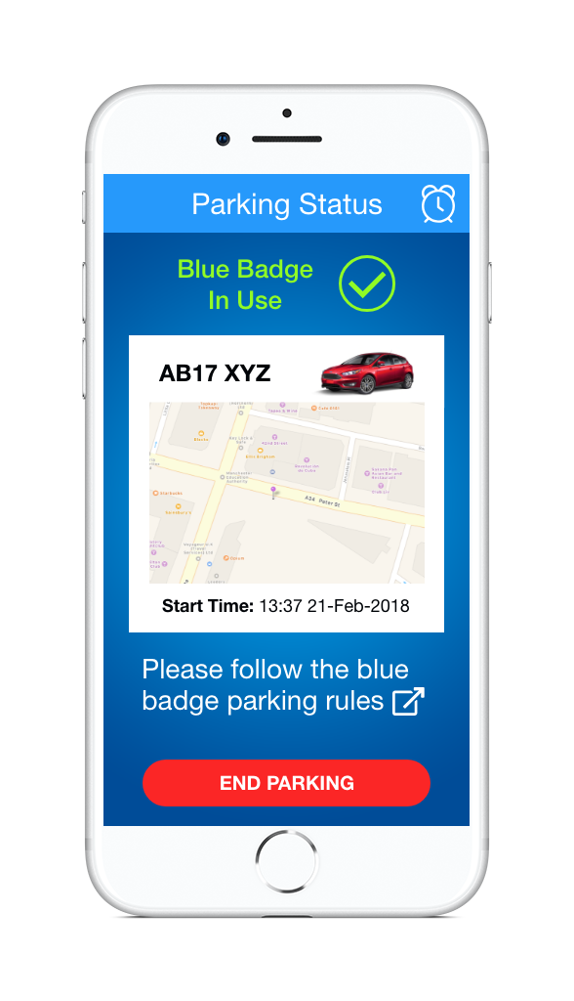
How it works
Register your badge
Enter the car you are in
Select use blue badge

Slide 6
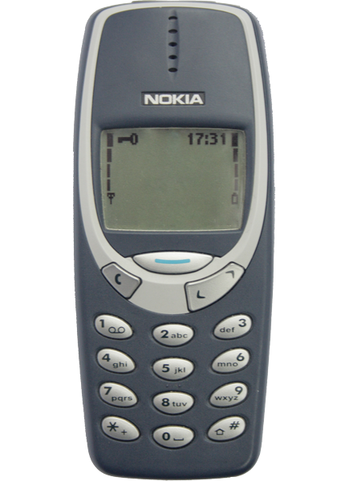
What about non-smartphone or app users?
Not everyone has a smartphone (but they will)
Older users may not be comfortable using an app
Interactive Voice System can be used
Tied to the drivers mobile phone number to authenticate them
“Please say your vehicles registration number”
“A B 1 7 X Y Z”
“Thank you, please call back when you return to your vehicle”

Slide 7

Behind the scenes
Registering the badge validates it with the
Blue Badge Improvement Service.
Only a single phone can be registered at any time.
When using the app the badge is recorded as being
in-use on the vehicle with the registration number entered.
Anyone wanting to verify the vehicle is using a blue badge can go to http://bluebadgeapp.org and enter the registration of the car.
  It will simply say if a blue badge is being used on the car at that time

Slide 8
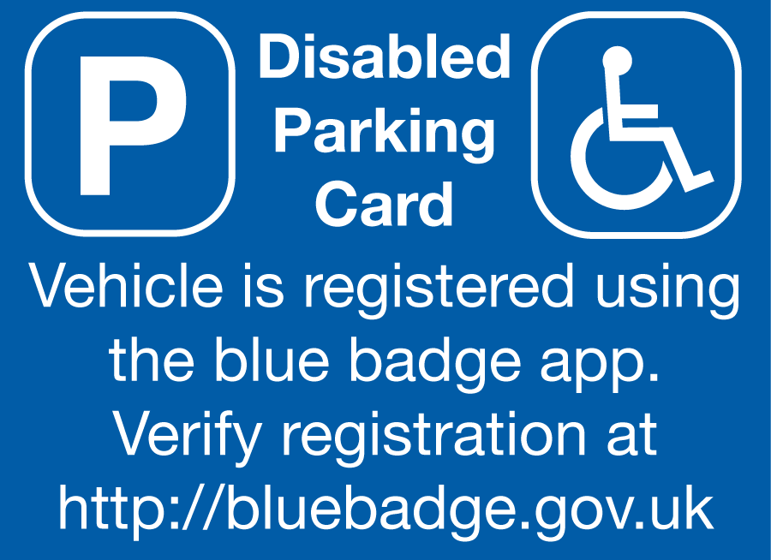
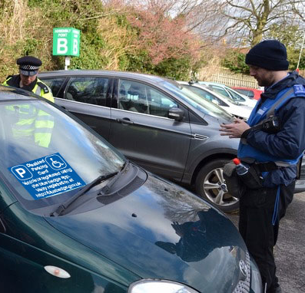
Showing a blue badge
Let everyone know a blue badge is being used
  Need to show it’s a disabled driver to stop people thinking the parking space is being abused
Indicate to officials its using the blue badge app
  and how to verify it
Blue Badge cards could be foldable or vinyl so they are easily carried
  or have multiple, as they are only valid when the app has registered their use

Slide 9
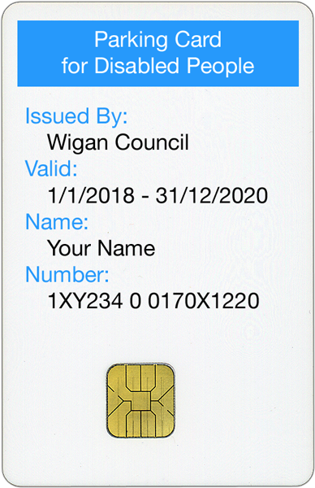
Physical Badges
Instead of the large badge, everyone who wants to use the app could be issued with a smaller credit card sized badge.
A credit card sized badge wouldn’t need to be displayed, just kept in your purse or wallet.
The card could have an embedded chip* for easy registration or require scanning every time to defeat double use
*NTAG 413 DNA NFC Chip stops cloning

Slide 10
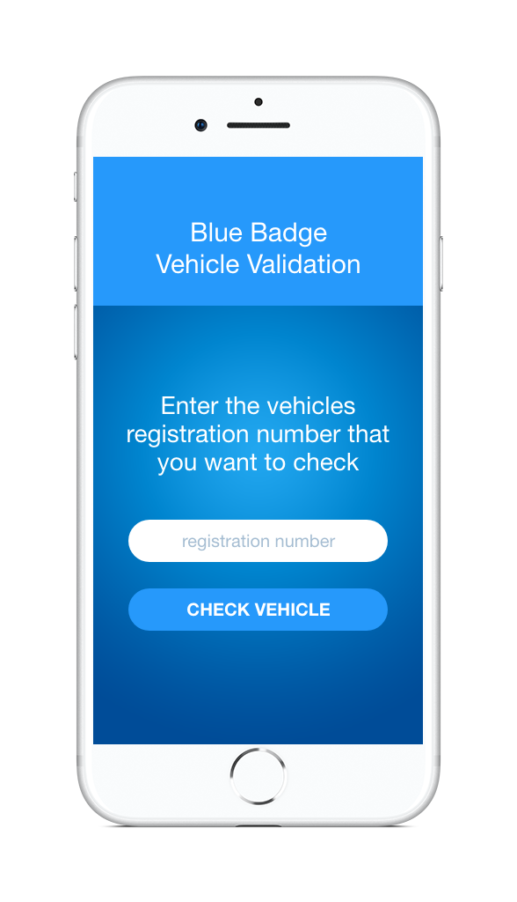
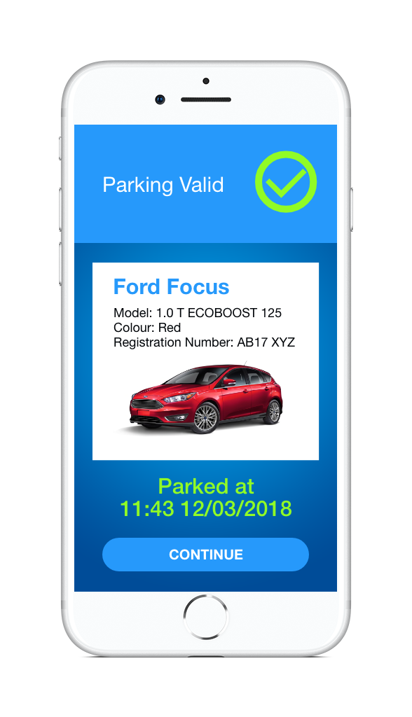
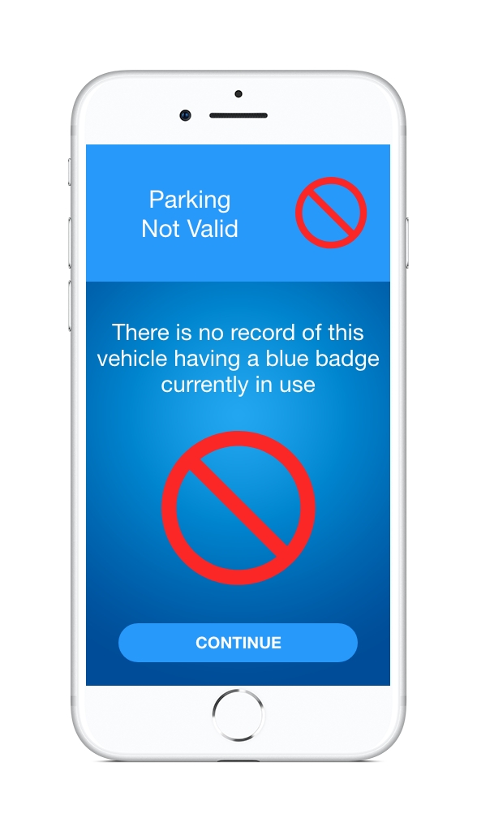
How to deal with enforcement
Web, App or API
  Could be publically available as all it checks is the registration number and says yes or no
  Lets private parking companies validate as well as public
  API allows for easy integration with existing systems

Slide 11
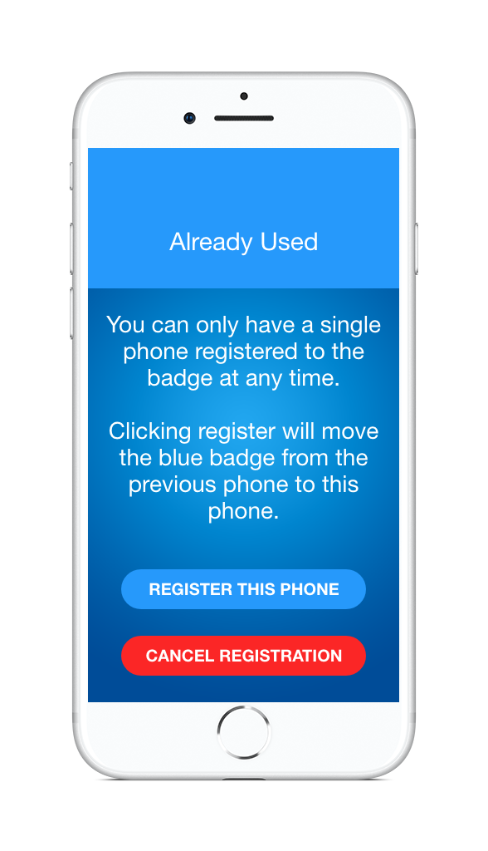
How can you stop multiple use?
Only allow registration to a single phone at a time
If someone tries to register to another phone, you can send a text message to the registered phone number to warn or stop it being moved.
An alternative would be to not use with the existing blue badges and only credit card sized badges with NFC chips.
  You could ask them to scan the card every time they used it. This would make sure they had the card with them.

Slide 12
Ending the session
Ask the user to enter the time at the start
Have a maximum time when its automatically stopped
  Alert the user before it expires and ask if still needed
Use GPS to match the parking location and automatically stop at the maximum allowed time
Automatically end at midnight
For multi-day parking require the user to specify the location
  or automatically get from the phone at time of parking
Lots of options depending on policy required

Slide 13

What about European Travel?
I travel abroad, what do I do then?
  You should be able to apply for a separate blue badge in a similar format to the existing.
  It can be marked with “NOT FOR USE IN THE UK” or similar to stop people using it when they return home.
  This has the disadvantage of requiring people to request another badge, or it could be automatically issued when people get a credit card sized badge.

Slide 14
No network service
How would this work in areas of poor network coverage, such as underground car parks?
  The app continues in the background to register the parking so that will send the parking information as soon as connectivity is restored.
  After 10 minutes if it still hasn’t sent the information it will sound an alarm on the phone to let the user know.
  The will then be able to press a button to send the request via an SMS text message.

Slide 15
I’m happy and don’t want this
If you are happy then there is no need to change.
Just carry on using your existing blue badge.
Please remember others do want this, having a choice will benefit everyone.
Existing cards and app based can live together

Slide 16
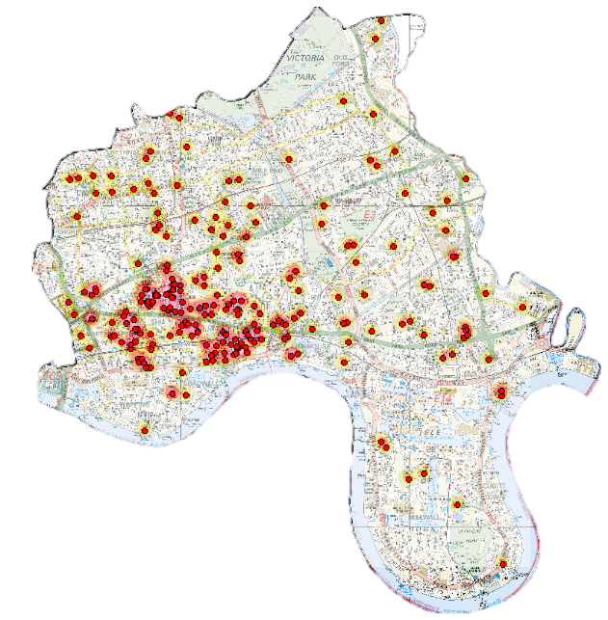
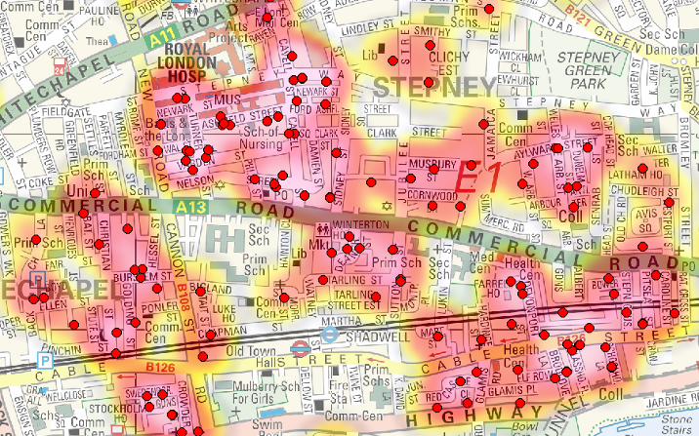

Case Study: London Borough of Tower Hamlets
60% of Thefts from motor vehicles (TFMVs) are of blue badges
279 Thefts last year
TOTAL POLICING

Slide 17
Take a demonstration
Online Demo at http://bluebadge.fuelService.org
Runs in a web browser or on your phone

Slide 18
Useful information
Blue badge thefts 'double in a year‘ BBC 2015
  http://www.bbc.co.uk/news/uk-34020743
'Callous' theft of disabled drivers' blue badges trebles
  Sebastian Mann Saturday 20 August 2016 08:11, Evening Standard, https://www.standard.co.uk/news/crime/callous-theft-of-disabled-drivers-blue-badges-trebles-a3325351.html
Video - Helen Dolphin from People's Parking recently went out with a Blue Badge Enforcement officer in Norfolk.
  This is what she found. https://www.facebook.com/Peoplesparking/videos/1890022834360771/
Blue Badge improvement service: a report on the first year of implementation
  Published 27 March 2013, Department for Transport
After the Crackdown: Was the Blue Badge Improvement Service a Success?
  http://www.accessmagazine.co.uk/after-the-crackdown-was-the-blue-badge-improvement-service-a-success/ July 28, 2015
Tackling Blue Badge Fraud - a good practice guide By London Councils
  https://www.londoncouncils.gov.uk/services/parking-services/parking-and-traffic/parking-information-professionals/tackling-blue-badge
Disabled Motoring UK
  https://www.disabledmotoring.org/

Slide 19
Thank You

